Slide 1

AirBNB Hotel Booking Analysis
Soumyadeep Chakraborty
[AICTE Internship ID- INTERNSHIP_17546440516895be537820f ]

Slide 2

PROBLEM STATEMENT
The objective of this project is to analyze Airbnb open data to understand factors influencing listing prices, popularity, and host performance. The study aims to identify patterns across neighborhoods, room types, and host characteristics to derive actionable insights for both hosts and potential guests.

Slide 3
Project Description
This project focuses on analyzing Airbnb open data to explore patterns in rental prices, host activity, availability, and customer reviews. The dataset contains various attributes such as listing name, location, neighbourhood group, room type, price, minimum nights, number of reviews, and host details.
The project follows a structured data analysis workflow that includes:
Data Loading and Understanding: Importing and exploring the dataset to understand its structure and key attributes.
Data Cleaning and Preprocessing: Handling missing values, removing duplicates, and converting data types for consistent analysis.
Exploratory Data Analysis (EDA): Visualizing and summarizing data to identify relationships between variables like price, location, and review ratings.
Feature Analysis: Evaluating how features such as room type, host verification, and neighbourhood influence listing performance.
Insights and Recommendations: Drawing meaningful conclusions that can help Airbnb hosts improve their listings and assist travelers in making better accommodation choices.
The goal of this project is to generate actionable insights from the Airbnb dataset that can help understand what factors contribute to successful listings and how pricing and availability vary across locations.

Slide 4

WHO ARE THE END USERS?
The end users of this Airbnb data analysis project include:
Airbnb Hosts – Hosts can use these insights to optimize their pricing strategies, improve guest experience, and understand how factors like reviews, room type, and location affect their listing’s popularity and revenue.
Potential Guests / Travelers – Guests can identify affordable and highly rated areas to stay in, based on average neighborhood prices, ratings, and room types.
Airbnb Management / Business Analysts – Airbnb’s internal teams can use the analysis to understand market dynamics, pricing trends, and customer preferences to enhance their platform’s recommendation and pricing algorithms.
Researchers & Data Analysts – This dataset also serves as a benchmark for exploring real-world data cleaning, feature engineering, and exploratory analysis techniques.

Slide 5

Technology Used
Python - Core programming language
Pandas & NumPy - Data cleaning and preprocessing
Scikit-learn - Machine learning (model training, regression, evaluation)
Matplotlib/Seaborn - Data visualization and feature importance
Google Colab - Cloud-based environment for running the project.

Slide 6
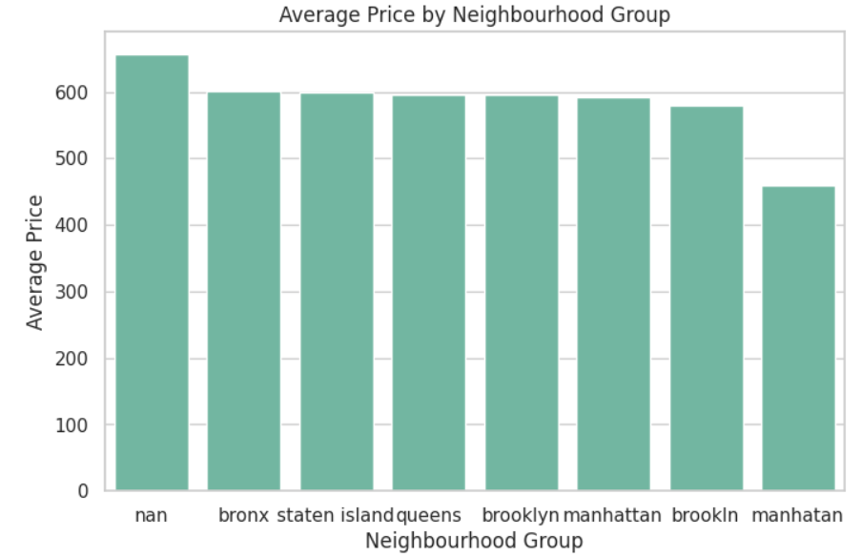
RESULTS1
What is the average price per neighbourhood group?
Demo Link

Slide 7
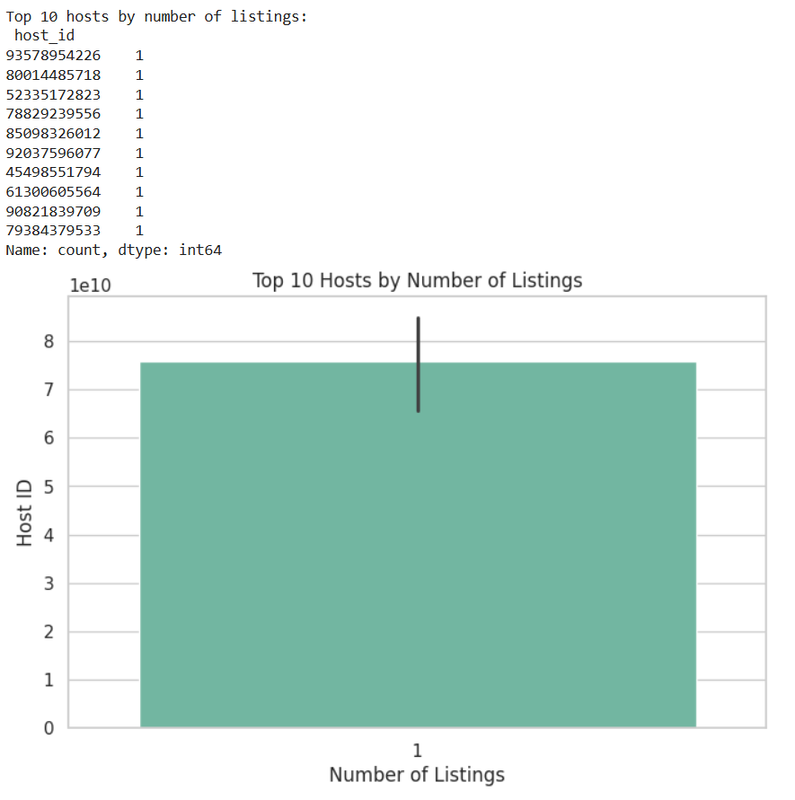
RESULTS2
Which hosts have the most listings?
Demo Link

Slide 8
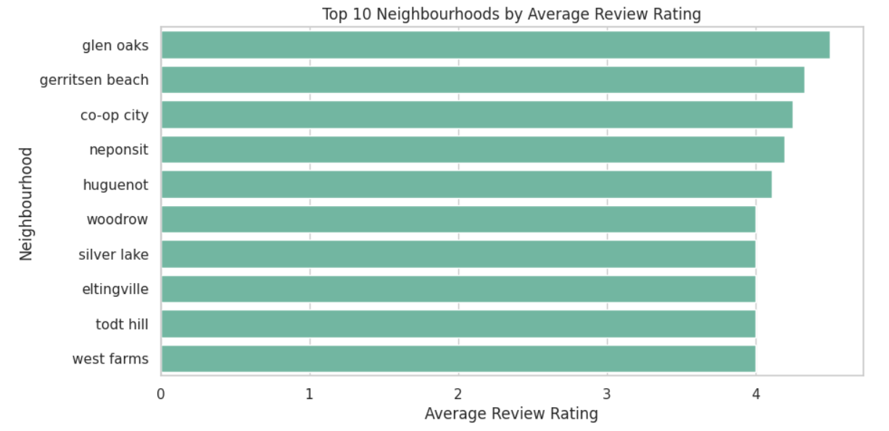
RESULTS3
Which neighbourhoods have the highest average review scores?
Demo Link

Slide 9
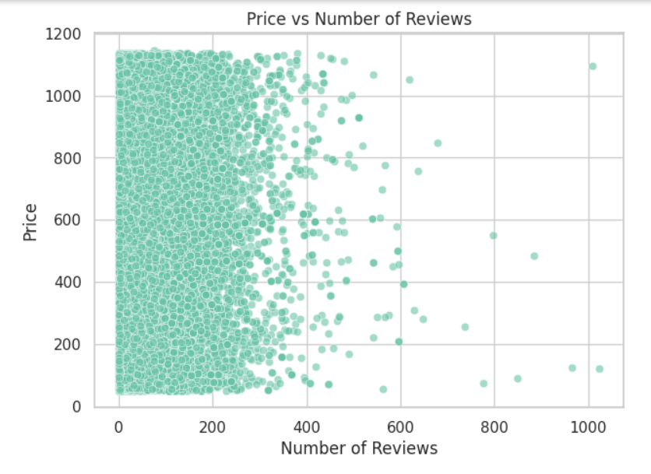
RESULTS4
What is the relationship between price and number of reviews?
Demo Link

Slide 10
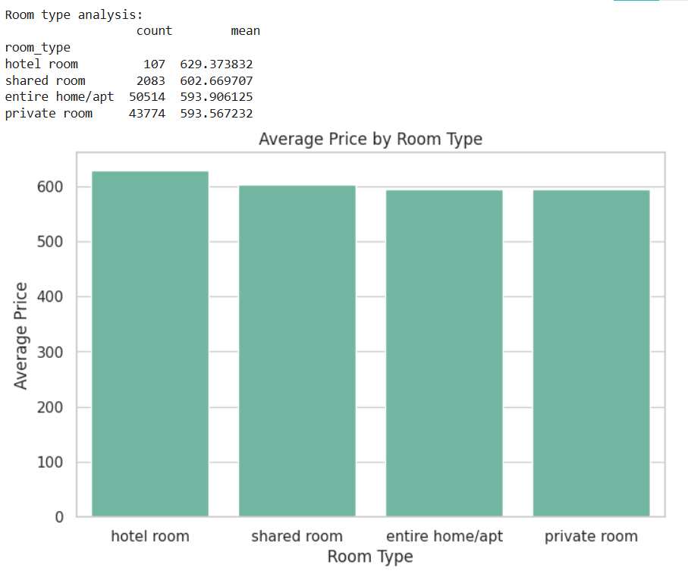
RESULTS5
Which room type is most popular and most expensive on average?
Demo Link

Slide 11
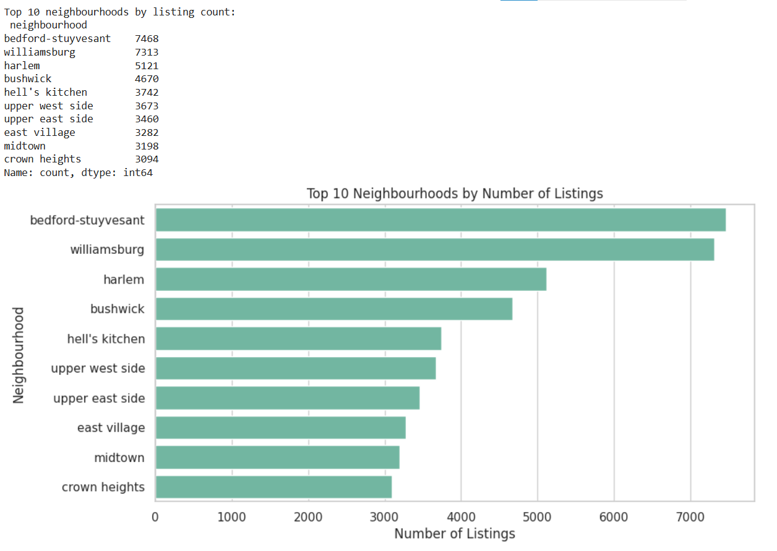
RESULTS6
Which neighbourhoods have the highest number of listings?
Demo Link

Slide 12
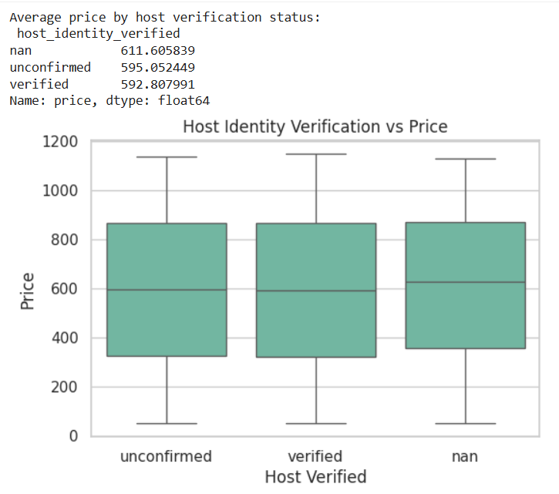
RESULTS7
How does host verification affect pricing?
Demo Link

Slide 13
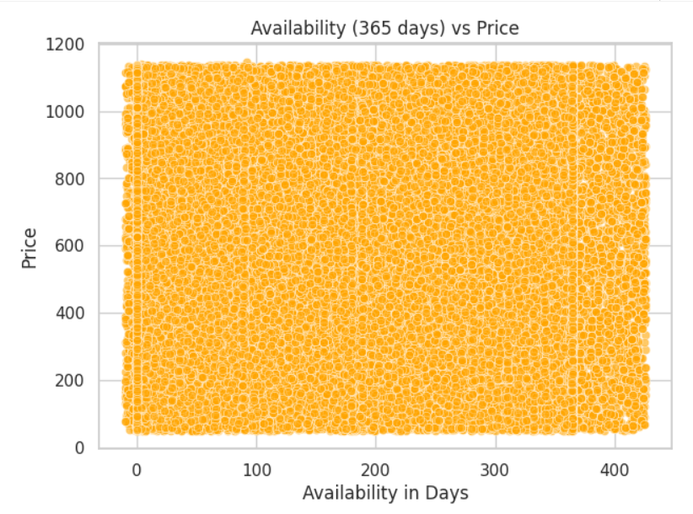
RESULTS8
Is there a relationship between availability and price?
Demo Link

Slide 14
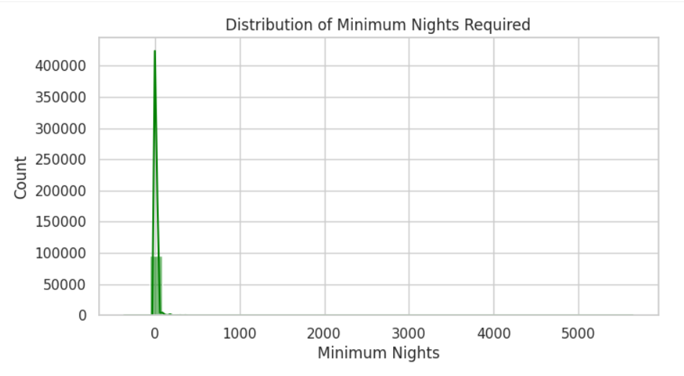
RESULTS9
What is the distribution of minimum nights required?
Demo Link

Slide 15
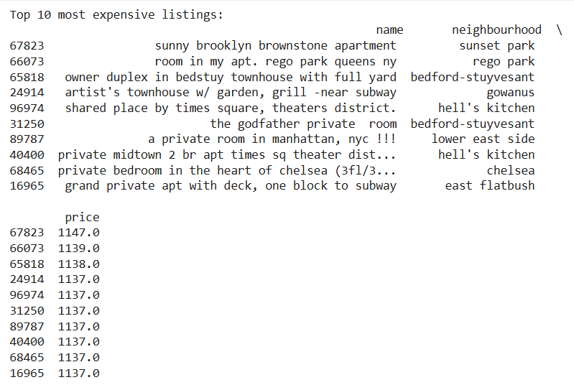
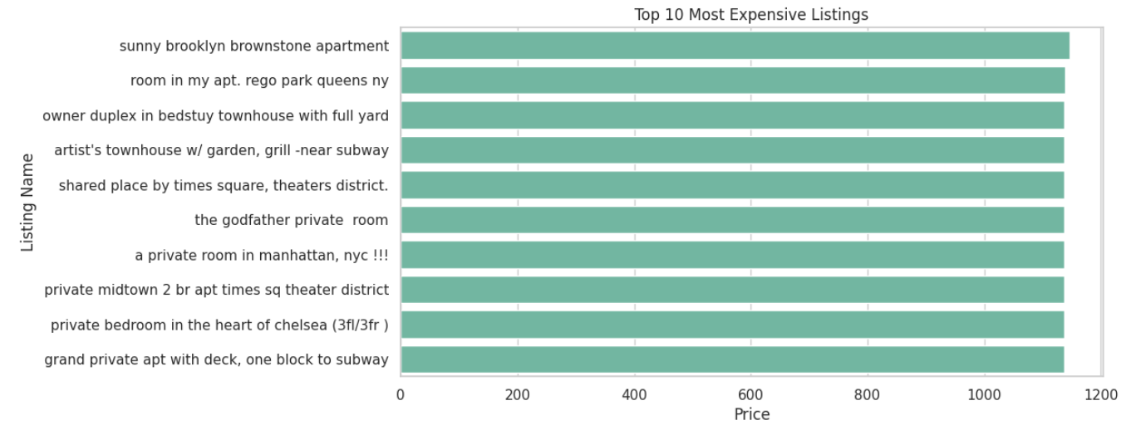
RESULTS10
What are the top 10 most expensive listings (name, price, neighbourhood)?
Demo Link

Slide 16
GitHub repository
[Add the working url of your github repository ]
https://github.com/sctua99831/VOIS_AICTE_Oct2025_SoumyadeepChakraborty.git
Demo Link

Slide 17

Getting started with Basics of Python Certificate

Slide 18
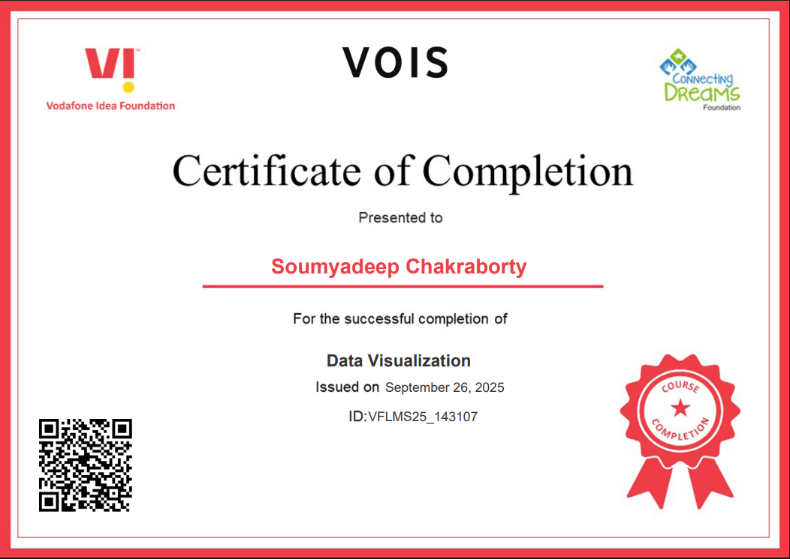
Data Visualization Certificate

Slide 19
Thank you
.
.

